Slide 1
Object-Oriented Systems
Analysis and Design Using UML
(Class Diagram)
Systems Analysis and Design Lab
Course Code: CSE 306
Fall 2021 Semester
Instructor:
Ali Zafar Sadiq
Lecturer. CSE Dept., UAP

Slide 2
Class Diagrams
In software engineering, a class diagram in the Unified Modeling Language (UML) is a type of static structure diagram that describes the structure of a system by showing the system's classes, their attributes, operations (or methods), and the relationships among objects.
A class diagram is a type of UML diagram that describes a system by visualizing the different types of objects within a system and the kinds of static relationships that exist among them. It also illustrates the operations and attributes of the classes.
18-<number>

Slide 3
Purpose of Class Diagrams
The purpose of the class diagram can be summarized as −
Analysis and design of the static view of an application.
Describe responsibilities of a system.
18-<number>

Slide 4
How to Draw a Class Diagram?
The following points should be remembered while drawing a class diagram −
The name of the class diagram should be meaningful to describe the aspect of the system.
Each element and their relationships should be identified in advance.
Responsibility (attributes and methods) of each class should be clearly identified
For each class, minimum number of properties should be specified, as unnecessary properties will make the diagram complicated.
Use notes whenever required to describe some aspect of the diagram. At the end of the drawing it should be understandable to the developer/coder.
Finally, before making the final version, the diagram should be drawn on plain paper and reworked as many times as possible to make it correct.
18-<number>

Slide 5
How to Draw a Class Diagram?
Step 1: Identify the class names
The first step is to identify the primary objects of the system.
Step 2: Distinguish relationships
Next step is to determine how each of the classes or objects are related to one another.
Step 3: Create the Structure
First, add the class names and link them with the appropriate connectors. You can add attributes and functions/ methods/ operations later.
18-<number>

Slide 6
Class Diagrams example
The following diagram is an example of an Order System of an application. It describes a particular aspect of the entire application.
First of all, Order and Customer are identified as two elements of the system. They have a one-to-many relationship because a customer can have multiple orders.
Order class is an abstract class and it has two concrete classes (inheritance relationship) SpecialOrder and NormalOrder.
The two inherited classes have all the properties as the Order class. In addition, they have additional functions like dispatch () and receive ().
18-<number>

Slide 7
Class Diagrams example
An abstract class is meant to be used as the base class from which other classes are derived.
The derived class is expected to provide implementations for the member functions that are not implemented in the base class.
A derived class that implements all the missing functionality is called a concrete class .
18-<number>

Slide 8
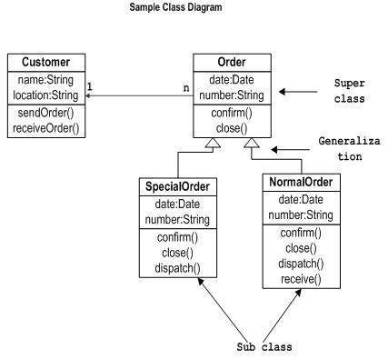
Class Diagrams example
18-<number>

Slide 9
Where to Use Class Diagrams?
Class diagram is a static diagram and it is used to model the static view of a system.
Showing the collaboration among the elements of the static view.
Describing the functionalities performed by the system.
Construction of software applications using object oriented languages.
18-<number>

Slide 10
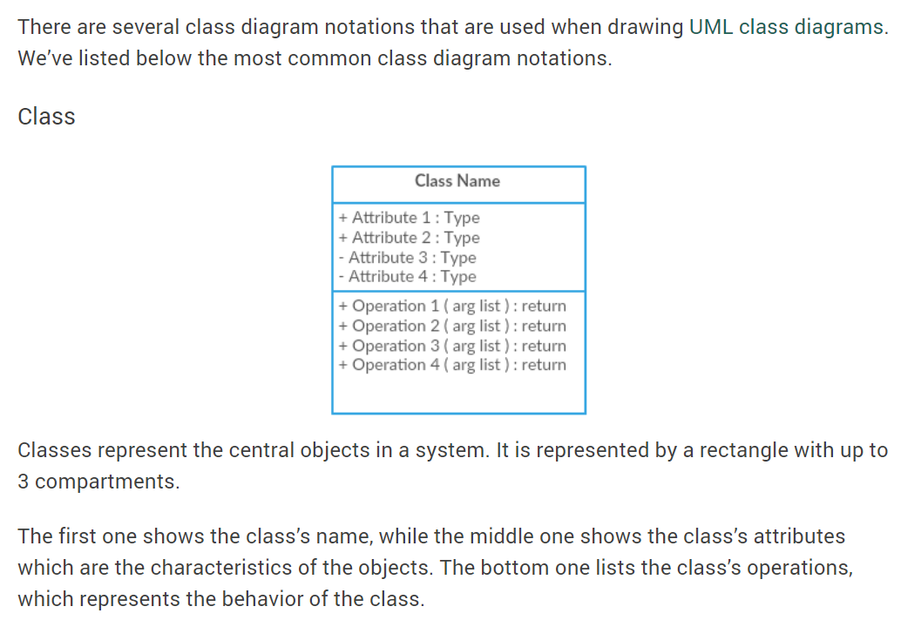
Class Diagram Notations with Examples
18-<number>

Slide 11
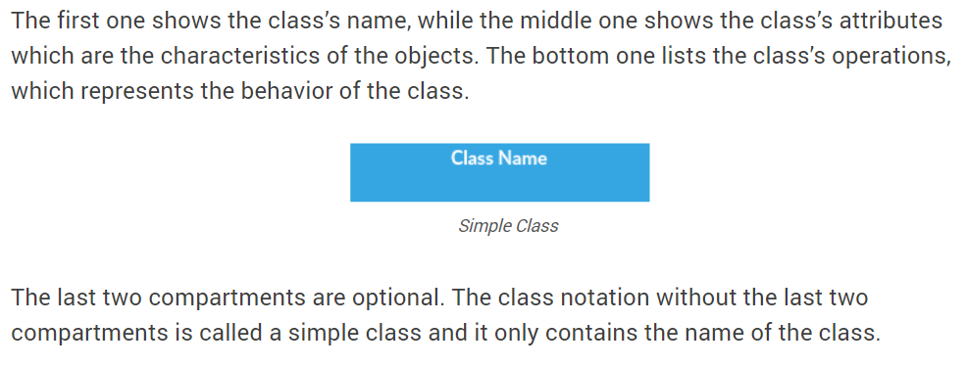
Class Diagram Notations with Examples
18-<number>

Slide 12
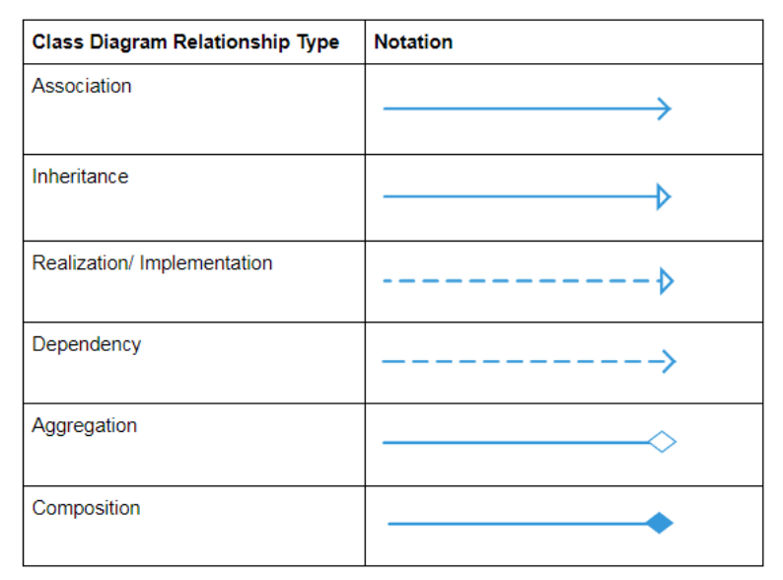
Class Diagram Relationships
18-<number>

Slide 13
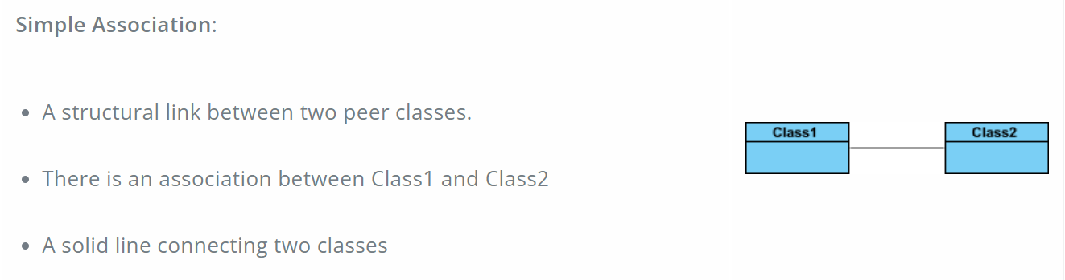
Class Diagram Relationships
18-<number>

Slide 14
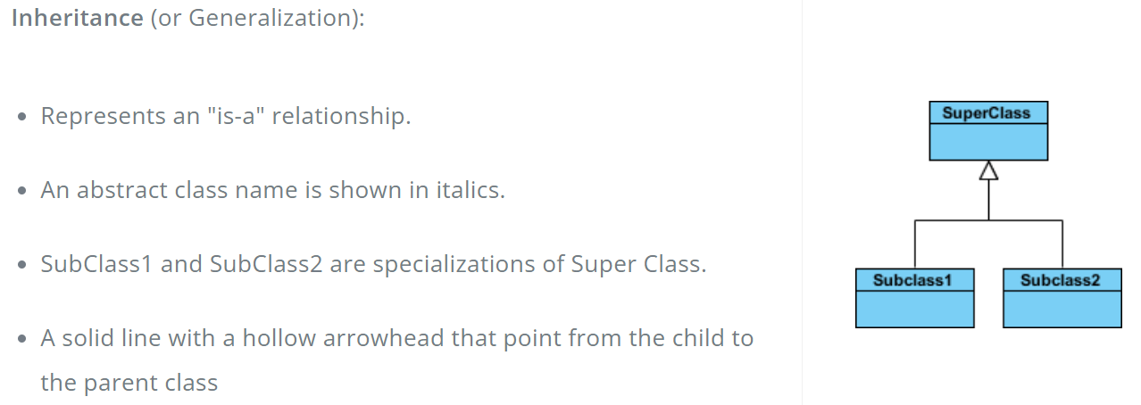
Class Diagram Relationships
18-<number>

Slide 15
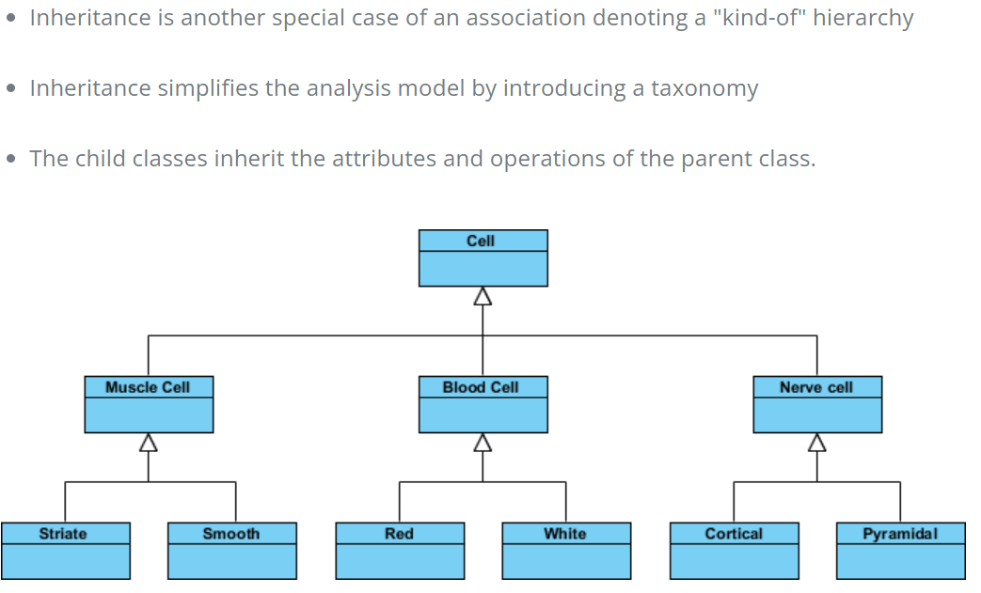
Inheritance Example - Cell Taxonomy
18-<number>

Slide 16
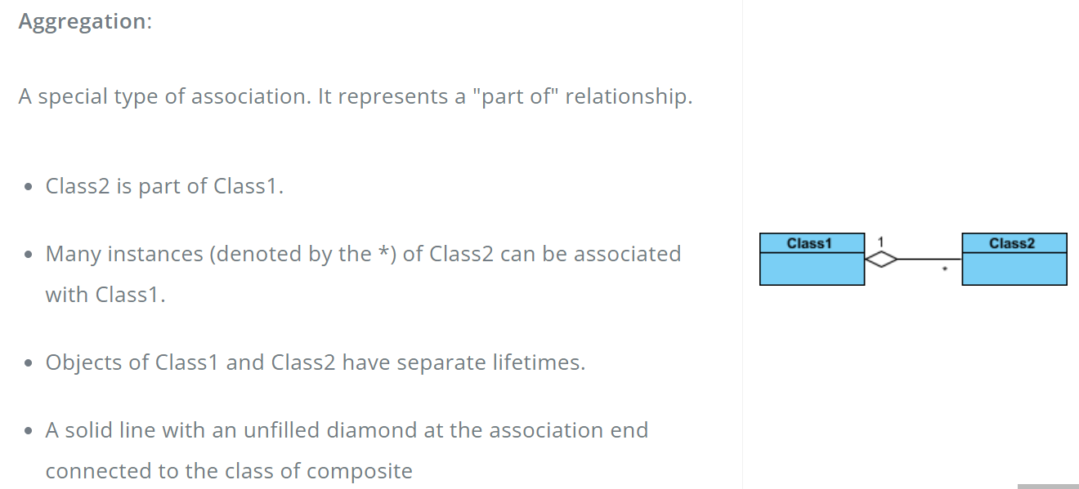
Class Diagram Relationships
18-<number>

Slide 17
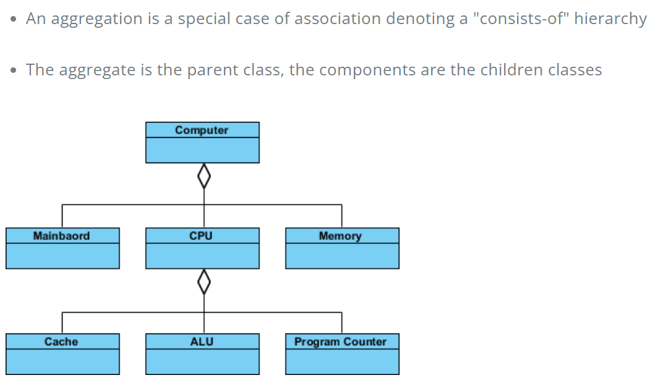
Aggregation Example - Computer and parts
18-<number>

Slide 18
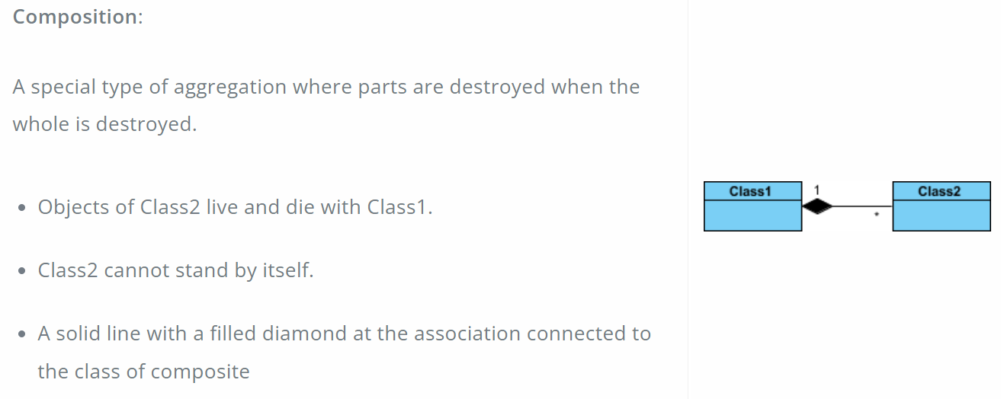
Class Diagram Relationships
18-<number>

Slide 19
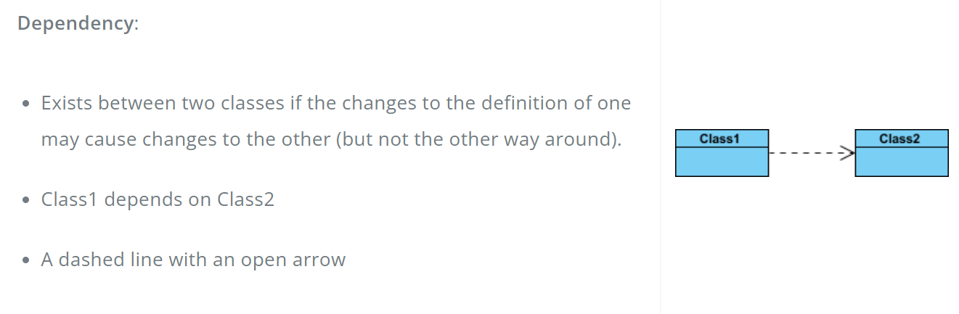
Class Diagram Relationships
18-<number>

Slide 20
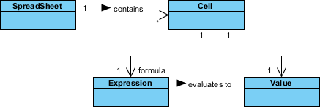
Relationship Names
Names of relationships are written in the middle of the association line.
Good relation names make sense when you read them out loud:
  "Every spreadsheet contains some number of cells",
  "an expression evaluates to a value"
They often have a small arrowhead to show the direction in which direction to read the relationship, e.g., expressions evaluate to values, but values do not evaluate to expressions.
18-<number>

Slide 21
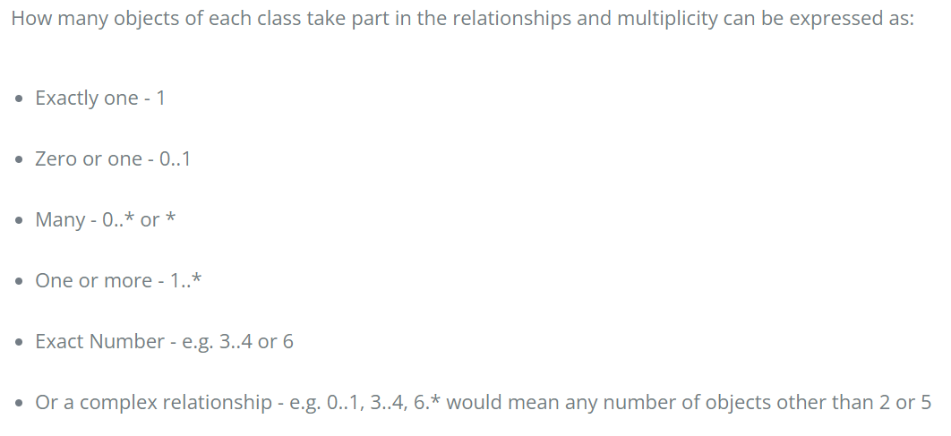
Multiplicity
18-<number>

Slide 22
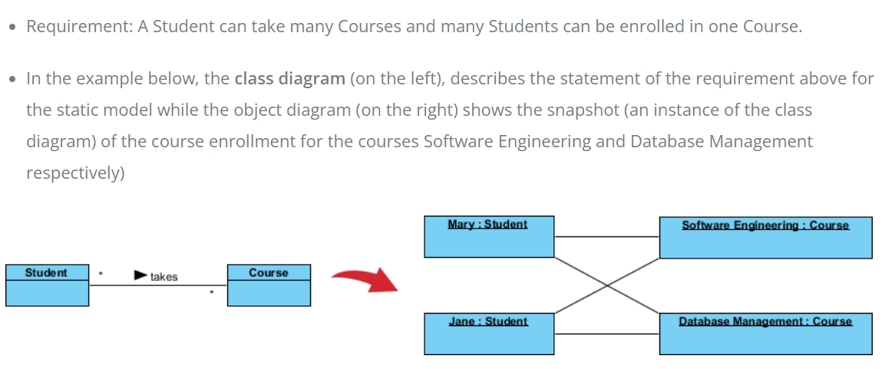
Multiplicity example
18-<number>

Slide 23
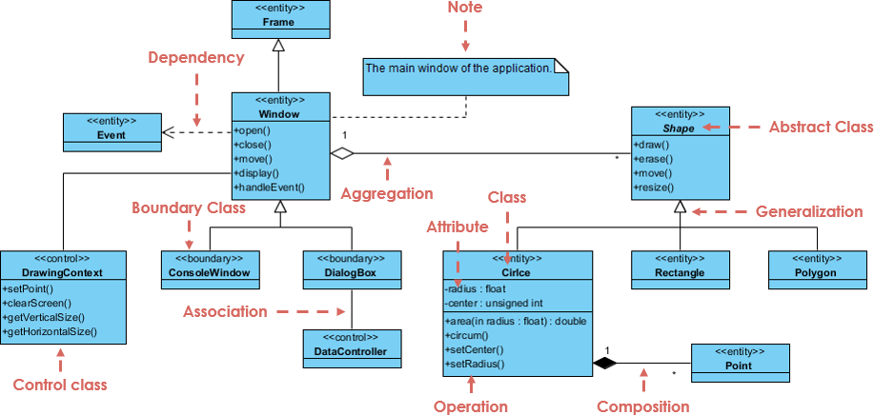
Class Diagram - Diagram Tool Example
A class diagram may also have notes attached to classes or relationships. Notes are shown in grey.
18-<number>

Slide 24
Class Diagram - Diagram Tool Example
In the example above:
We can interpret the meaning of the above class diagram by reading through the points as following.
Shape is an abstract class. It is shown in Italics.
Shape is a superclass. Circle, Rectangle and Polygon are derived from Shape. In other words, a Circle is-a Shape. This is a generalization / inheritance relationship.
There is an association between DialogBox and DataController.
Shape is part-of Window. This is an aggregation relationship. Shape can exist without Window.
Point is part-of Circle. This is a composition relationship. Point cannot exist without a Circle.
Window is dependent on Event. However, Event is not dependent on Window.
The attributes of Circle are radius and center. This is an entity class.
The method names of Circle are area(), circum(), setCenter() and setRadius().
The parameter radius in Circle is an in parameter of type float.
The method area() of class Circle returns a value of type double.
The attributes and method names of Rectangle are hidden. Some other classes in the diagram also have their attributes and method names hidden.
18-<number>

Slide 25
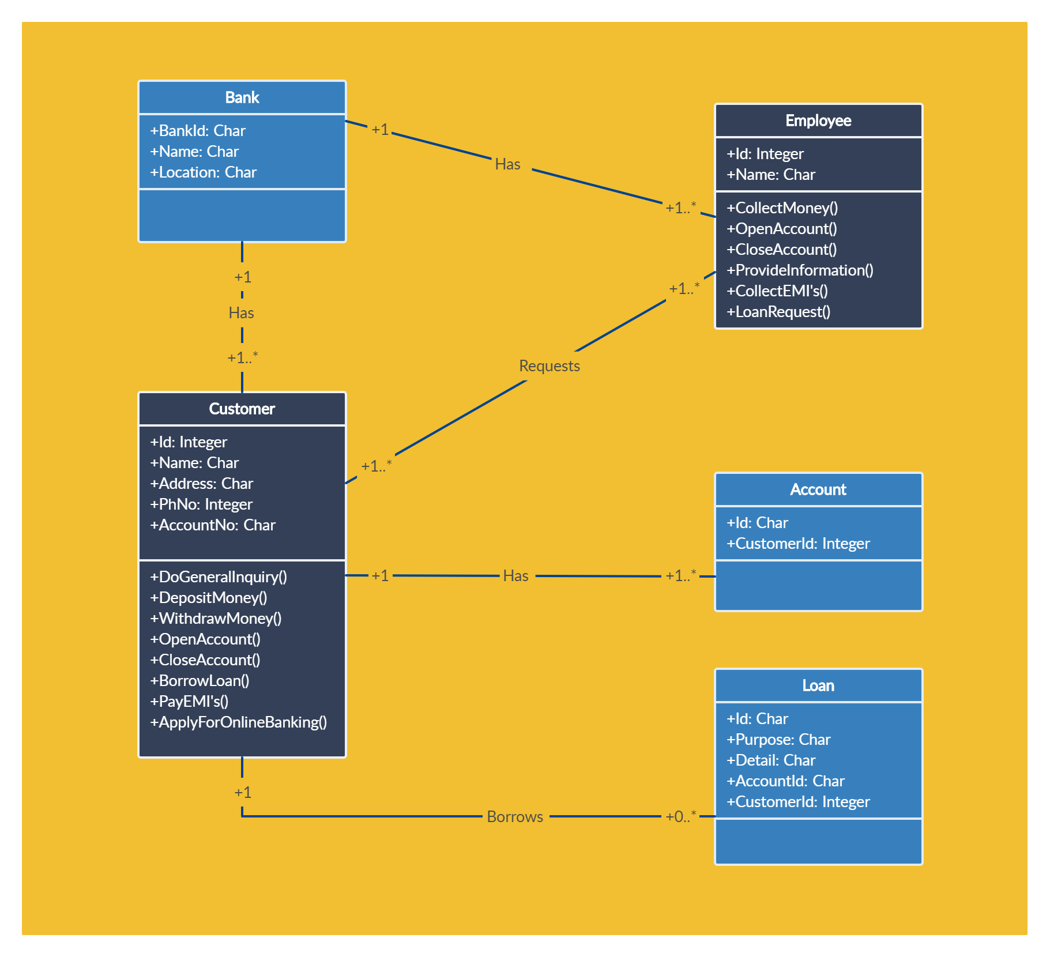
Class Diagram more example
18-<number>

Slide 26
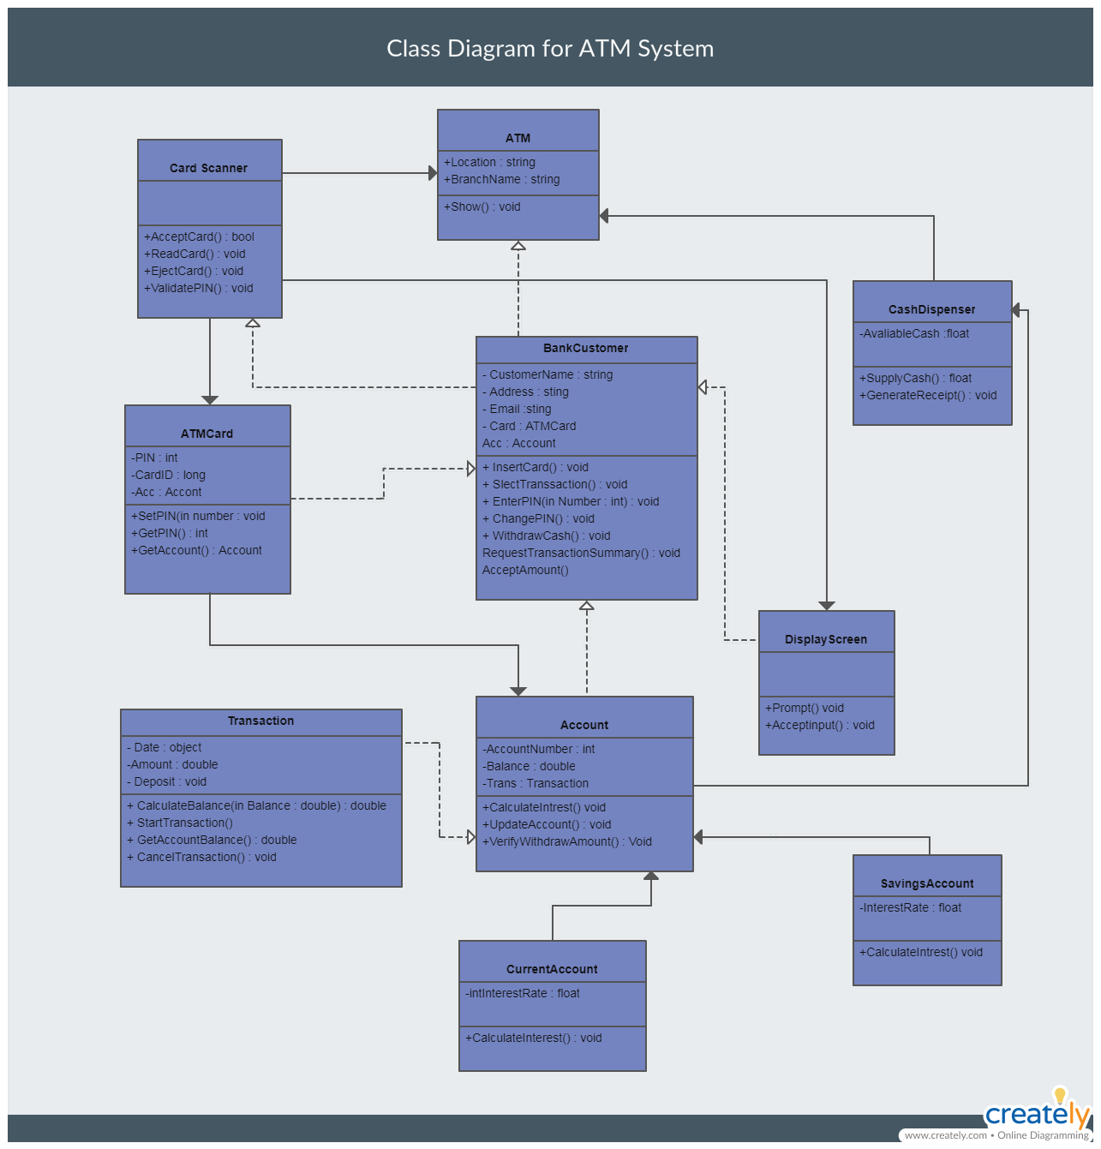
Class Diagram more example
18-<number>

Slide 27
Steps Used in UML
The steps used in UML are:
  Define the use case model.
  Continue UML diagramming to model the system. during the systems analysis phase.
  Develop the class diagrams.
  Draw statechart diagrams.
  Begin systems design by refining the UML diagrams.
  Document your system design in detail.
18-<number>

